Slide 1
Reliability Modelling - using Predictive analytics
UNDERSTANDING
PARAMETERS
Accessing
parameters
Identify CRITICAL
PARAMETERS
IMPLEMENT
THE MODEL
Reliability modeling is the process of predicting or understanding the reliability of a component or system prior to its implementation. The chosen domain is healthcare & the system is composed of components that are essentially physico-chemical properties of a drug & their interaction with a living cell. The tool could be seen as a key to eliminate manual experiments & save cost hence the data is cooked from real time experiments & analytical measurements. Assumption made: the parameters vary linearly.

Slide 2
Reliability Modelling - using Predictive analytics
01
Problem Statement : The Success of a new drug for medical application depends on many parameters. For real time design & optimization of drug kinetics, predictive analytics can help in arriving at the most reliable model factor to be considered for implementation
02
Business Understanding: Reliability modeling helps in saving time, resource & Cost for the company since it reduces human effort drastically by providing the right insight for decision making. Hence Predicting parameters based on experimental data is critical
03
Scientific & Data Approach: Defining the scope of the prediction based on boundary conditions & relationships between the model parameters is the key step in the analysis. The Objective of the model is to predict as accurate as possible based on few assumptions.

Slide 3

Descriptive Study on Data
1
Hydration Component
6
Process Solvent
Minimum | 0.0
Maximum | 27.5
Average | 21.3
Minimum
Maximum
Average
16.0
27.0
18.1
Input Parameters
Drug Reactivity
2
Solvation Component
7
Delivery Agent
Minimum
Maximum
Average
3.2
12.4
10.2
Minimum
Maximum
Average
0.0
20.0
6.0
3
Surfactant Concentration
8
Saturation Component
Minimum
Maximum
Average
24.9
71.8
59.1
Minimum
Maximum
Average
9.0
42.0
37.1
4
Drug Composition
9
Inert Agent
Minimum
Maximum
Average
0.0
6.0
2.2
Minimum
Maximum
Average
0.0
6.0
2.3
5
Drug Reacted Composition
10
Solubilizer
Minimum
Maximum
Average
0.0
4.4
0.8
Minimum
Maximum
Average
0.0
6.0
1.0

Slide 4
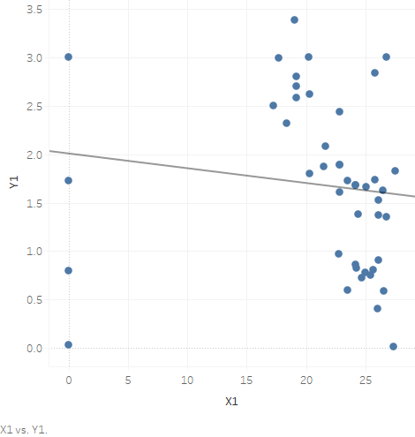
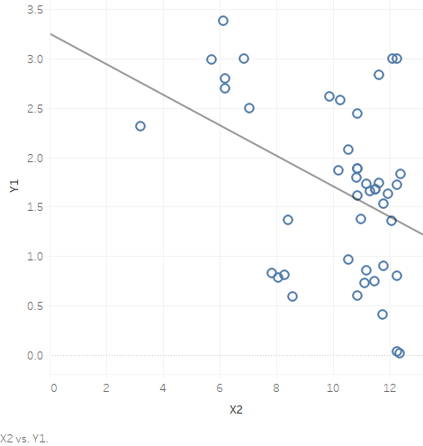
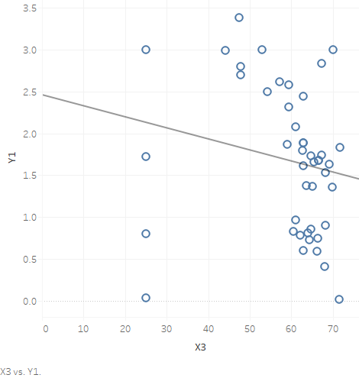
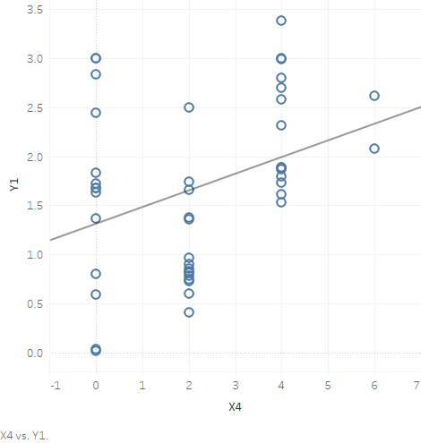
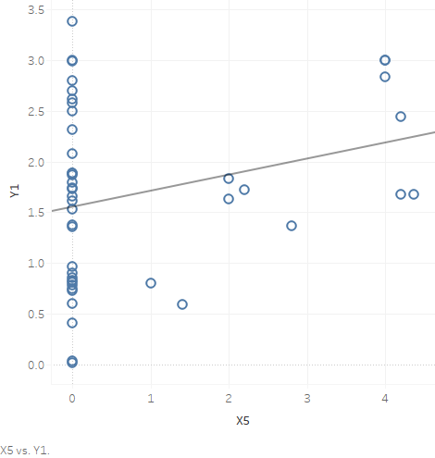
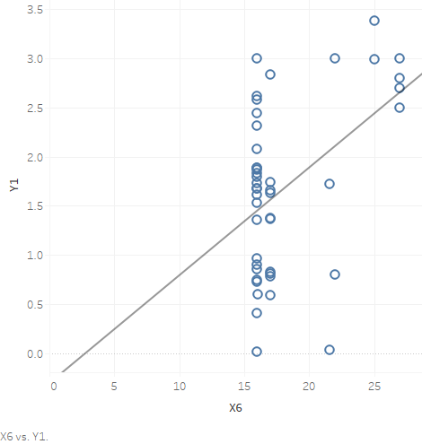
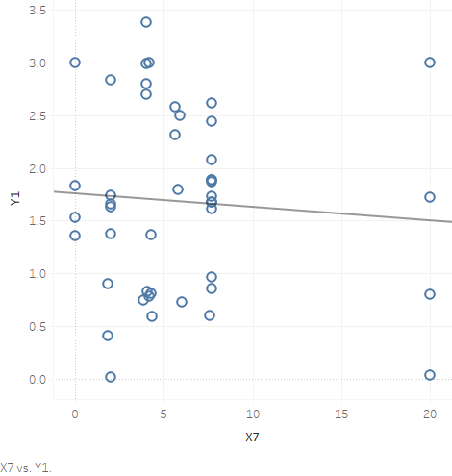
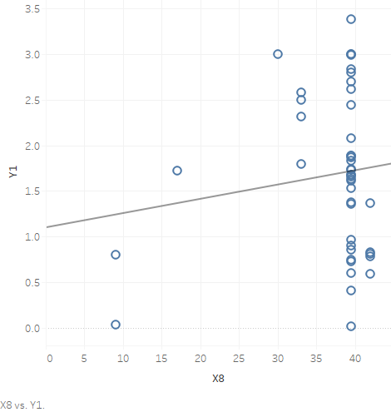
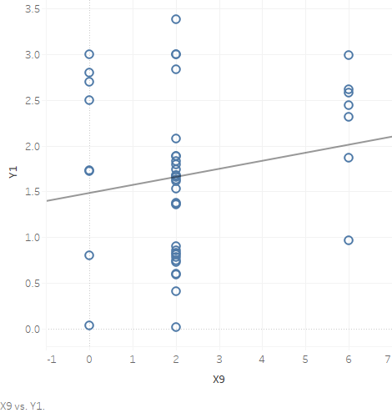
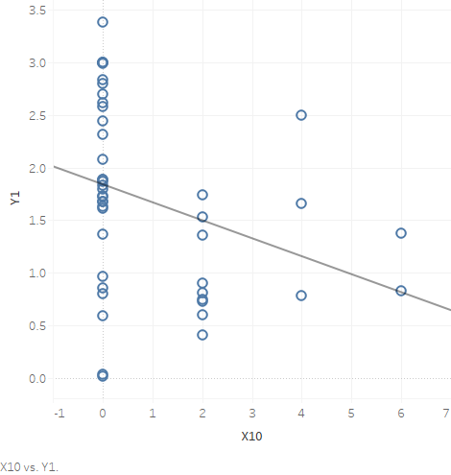
X1
X2
X3
X4
X5
Hydration Component
Solvation Component
Surfactant
Concentration
Drug Composition
Drug Reacted
Composition
Process Solvent
Delivery Agent
Saturation Component
Inert Agent
Solubilizer
X6
X7
X8
X9
X10

Slide 5
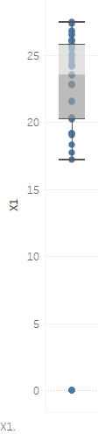
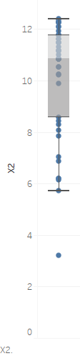
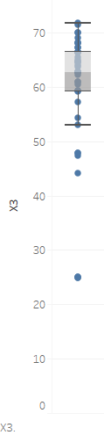
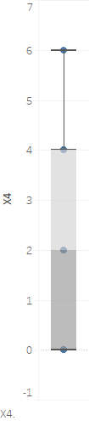
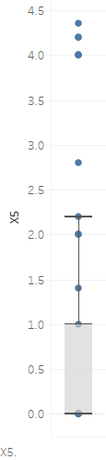
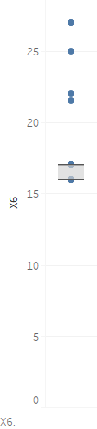
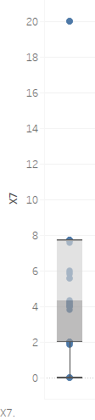
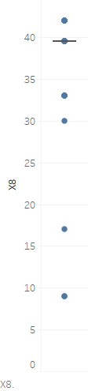
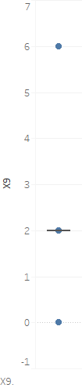
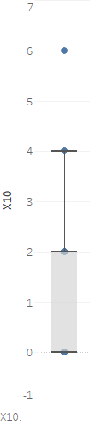
Since each variables have different scale of measurement, the box plot cannot be used for comparsion between variables however the distribution of the variables & mathematical outliers could be detected

Slide 6
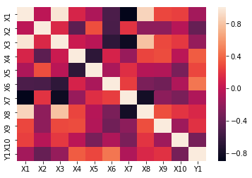
Key Findings
1)Some of the independent factors are highly correlated with each other
2)The Dependent Variables have non linear relationship with the Independent variables
3)The distribution of the independent variables do not follow a normal curve
4)There are outliers mathematically but scientifically they are justifiable
5)The Data is available for 45 Experiments only. So data cannot be added or manipulated
X1 VIF: 78.01
X2 VIF: 2.59
X3 VIF: 49.01
X4 VIF: 3.67
X5 VIF: 3.5
X6 VIF: 7.05
X7 VIF: 10.43
X8 VIF: 11.68
X9 VIF: 1.92
X10 VIF: 1.66

Slide 7
Model Building - I
Data Transformation
Multiple Regression(Split,Train,Test)
Evaluation of OLS Summary
Backward Elimination
Model Accuracy metrics

Slide 8
import pandas as pd
data=pd.read_excel('Predictive Modelling.xlsx')
correlation=data.corr()
import seaborn as sns
sns.heatmap(correlation)
x=data.iloc[:,[3,4,5,6]].values
y=data.iloc[:,10].values
import statsmodels.formula.api as sm
def vif_cal(input_data,dependent_col):
x_var=input_data.drop([dependent_col],axis=1)
xvar_names=x_var.columns
for i in range(0,len(xvar_names)):
y=x_var[xvar_names[i]]
x=x_var[xvar_names.drop(xvar_names[i])]
rsq=sm.ols("y~x",x_var).fit().rsquared
vif=round(1/(1-rsq),2)
print(xvar_names[i],"VIF:",vif)
data1=data.drop(['X10'],axis=1)
data2=data1.drop(['X2'],axis=1)
data3=data2.drop(['X9'],axis=1)
data4=data3.drop(['X8'],axis=1)
data5=data4.drop(['X3'],axis=1)
data6=data5.drop(['X1'],axis=1)
vif_cal(data6,'Y1’)
from sklearn.model_selection import train_test_split
x_train,x_test,y_train,y_test=train_test_split(x,y,test_size=0.20,random_state=0)
import statsmodels.formula.api as sm
regress=sm.OLS(y_train,x_train).fit()
regress.summary()
from sklearn.metrics import mean_squared_error,r2_score
from math import sqrt
y_pred=regress.predict(x_test)
print(sqrt(mean_squared_error(y_test,y_pred)))
#0.53
import numpy as np
#new metrics
# finding the mean for test data value
base_pred = np.mean(y_test)
print(base_pred)
# Repeating same value till length of test data
base_pred = np.repeat(base_pred, len(y_test))
# finding the RMSE
from sklearn.metrics import mean_squared_error
base_RMSE =(mean_squared_error(y_test,base_pred))**0.5
print(base_RMSE)
#0.64

Slide 9
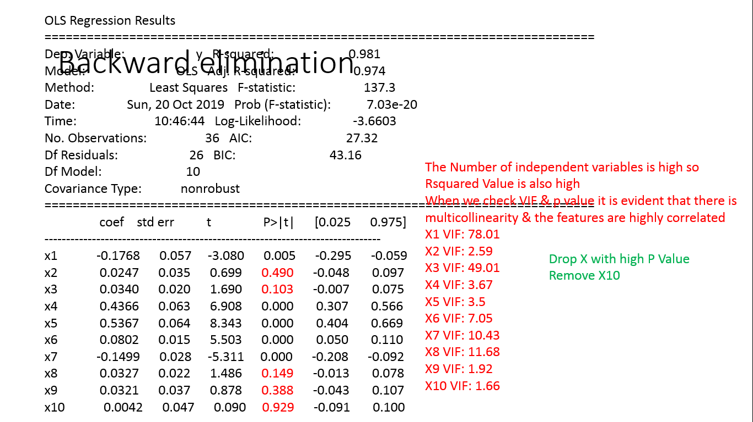
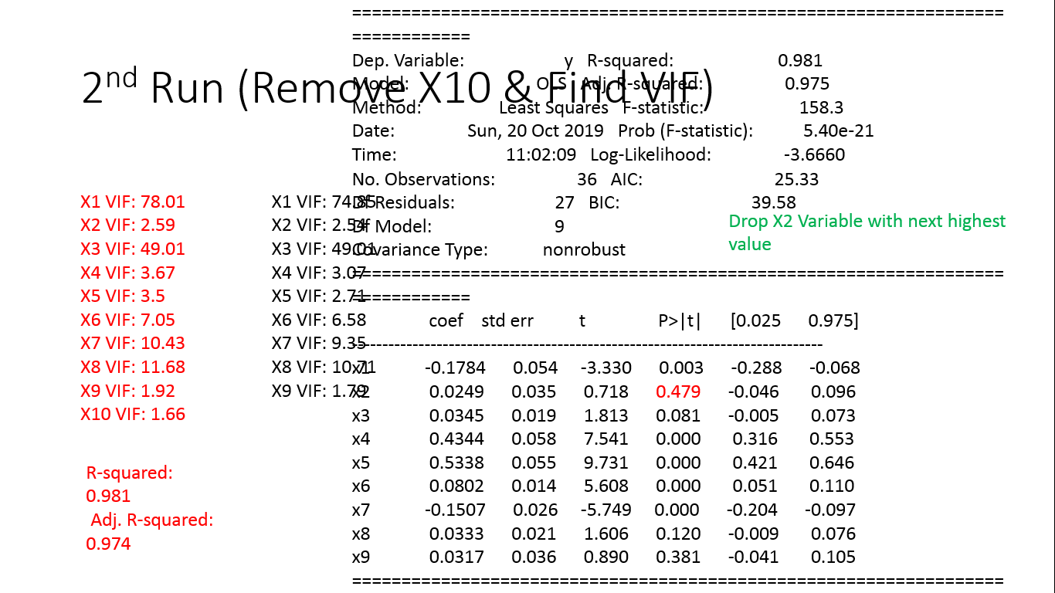
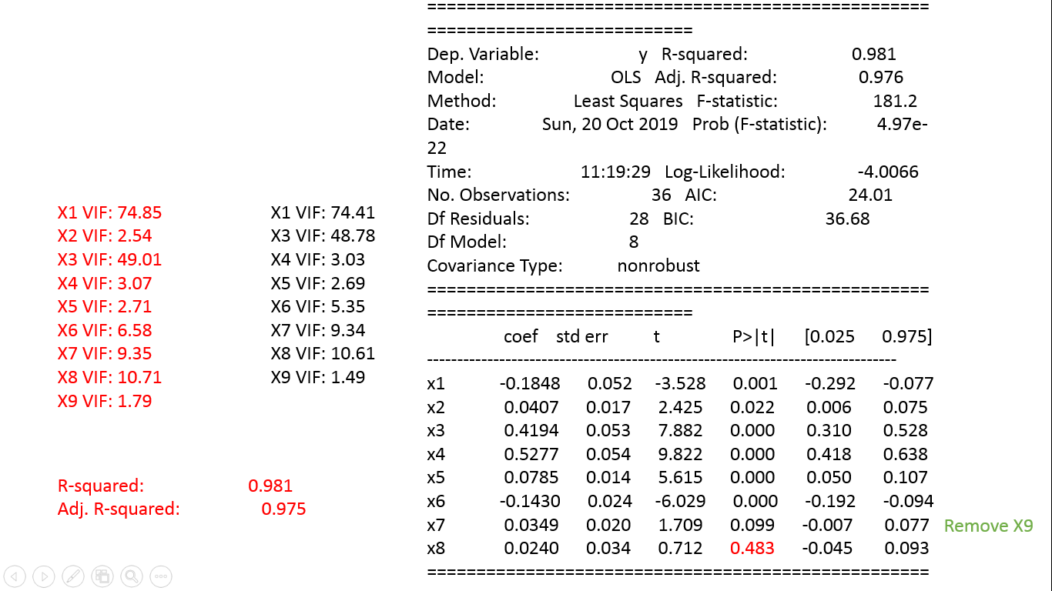
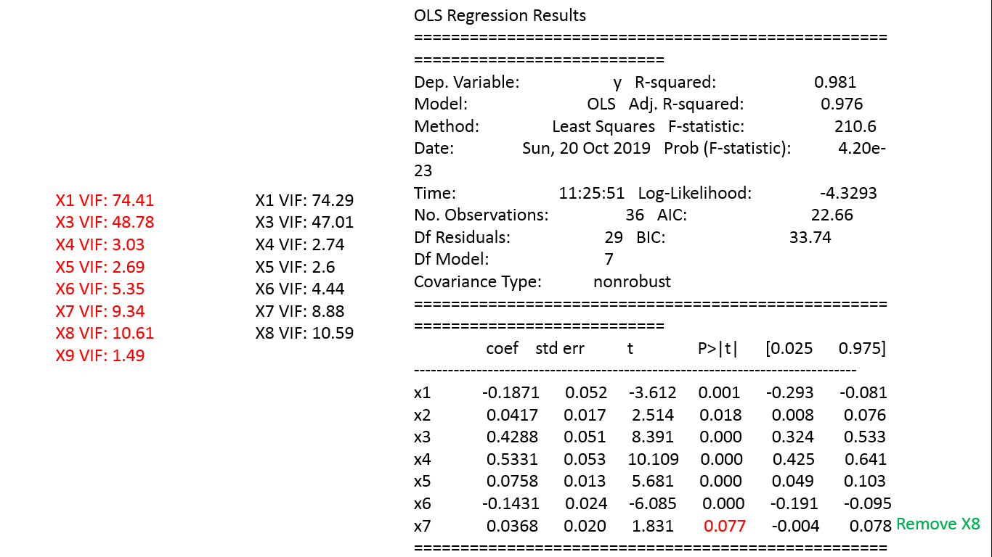
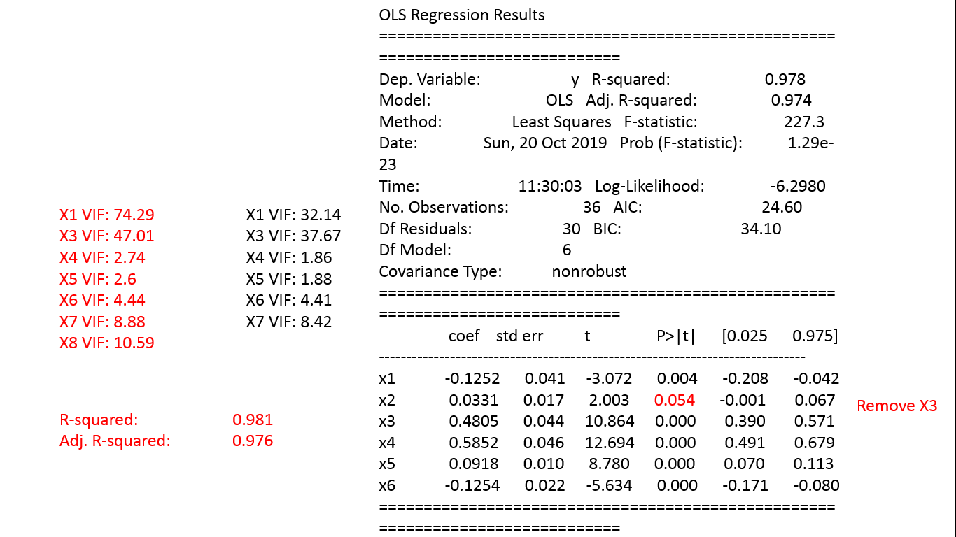
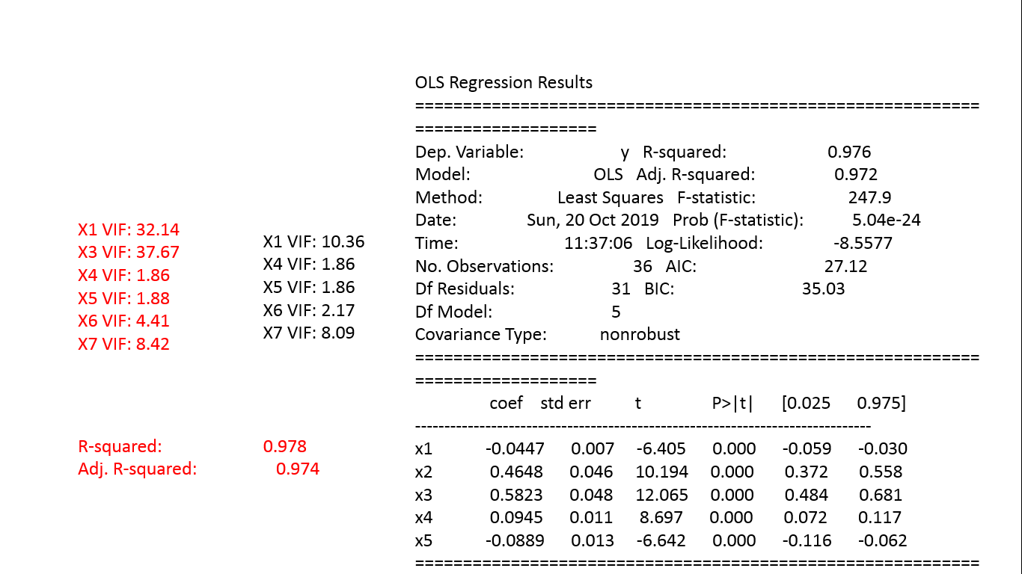
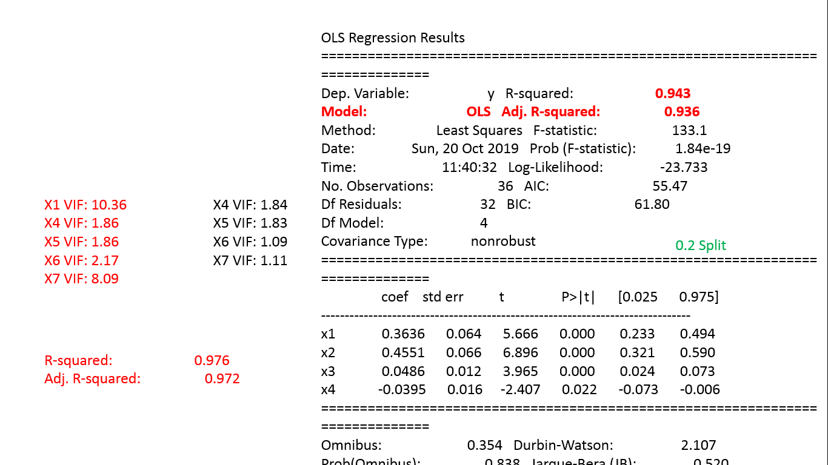
Model Evaluation
X1 VIF: 78.01
X2 VIF: 2.59
X3 VIF: 49.01
X4 VIF: 3.67
X5 VIF: 3.5
X6 VIF: 7.05
X7 VIF: 10.43
X8 VIF: 11.68
X9 VIF: 1.92
X10 VIF: 1.66
X1 VIF: 74.41
X3 VIF: 48.78
X4 VIF: 3.03
X5 VIF: 2.69
X6 VIF: 5.35
X7 VIF: 9.34
X8 VIF: 10.61
X9 VIF: 1.49
X1 VIF: 74.85
X2 VIF: 2.54
X3 VIF: 49.01
X4 VIF: 3.07
X5 VIF: 2.71
X6 VIF: 6.58
X7 VIF: 9.35
X8 VIF: 10.71
X9 VIF: 1.79
X1 VIF: 74.29
X3 VIF: 47.01
X4 VIF: 2.74
X5 VIF: 2.6
X6 VIF: 4.44
X7 VIF: 8.88
X8 VIF: 10.59
X1 VIF: 32.14
X3 VIF: 37.67
X4 VIF: 1.86
X5 VIF: 1.88
X6 VIF: 4.41
X7 VIF: 8.42
X1 VIF: 10.36
X4 VIF: 1.86
X5 VIF: 1.86
X6 VIF: 2.17
X7 VIF: 8.09
X4 VIF: 1.84
X5 VIF: 1.83
X6 VIF: 1.09
X7 VIF: 1.11
VIF
R²
Adj. R²
0.981
0.976
0.976
0.972
0.943
0.936
0.981
0.976
0.978
0.974
0.981
0.975
0.981
0.974
P value

Slide 10
OLS Regression Results
==============================================================================
Dep. Variable: y R-squared: 0.943
Model: OLS Adj. R-squared: 0.936
Method: Least Squares F-statistic: 133.1
Date: Sun, 20 Oct 2019 Prob (F-statistic): 1.84e-19
Time: 11:40:32 Log-Likelihood: -23.733
No. Observations: 36 AIC: 55.47
Df Residuals: 32 BIC: 61.80
Df Model: 4
Covariance Type: nonrobust
==============================================================================
coef std err t P>|t| [0.025 0.975]
------------------------------------------------------------------------------
x1 0.3636 0.064 5.666 0.000 0.233 0.494
x2 0.4551 0.066 6.896 0.000 0.321 0.590
x3 0.0486 0.012 3.965 0.000 0.024 0.073
x4 -0.0395 0.016 -2.407 0.022 -0.073 -0.006
==============================================================================
Omnibus: 0.354 Durbin-Watson: 2.107
Prob(Omnibus): 0.838 Jarque-Bera (JB): 0.520
Skew: 0.069 Prob(JB): 0.771
Kurtosis: 2.427 Cond. No. 20.4
==============================================================================

Slide 11
Model Building - II
Principal Component Analysis
Multiple Regression(Split,Train,Test)
Evaluation of OLS Summary
Backward Elimination
Model Accuracy metrics

Slide 12
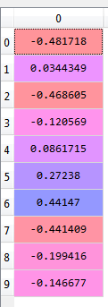
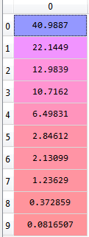
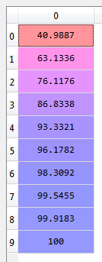
import matplotlib.pyplot as plt
import numpy as np
import pandas as pd
data=pd.read_excel('Reliability modelling.xlsx')
m=data.iloc[:,:10].values
n=data.iloc[:,10].values
from sklearn.preprocessing import StandardScaler
sc=StandardScaler()
m=sc.fit_transform(m)
#Standard Scaler returns a float array therefore convert into dataframe
m=pd.DataFrame(m)
from sklearn.decomposition import PCA
pca=PCA()
m=pca.fit_transform(m) #Fits the components after rotational transformation
scores.abs().sort_values(ascending=False)
0 0.481718
2 0.468605
6 0.441470
7 0.441409
5 0.272380
8 0.199416
9 0.146677
3 0.120569
4 0.086171
1 0.034435
dtype: float64
This implies Feature 1,3,7,8,6,9 are the first 6 Principal components
Eigen values
%Explained
variances
%Cumulative Variances
*pca.components_[0]
**res=pca.explained_variance_ratio_*100
***np.cumsum(pca.explained_variance_ratio_*100)
scores=pd.Series(pca.components_[0])
scores.abs().sort_values(ascending=False)
# # Displays index Absolute Eigen values

Slide 13
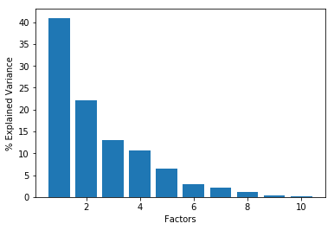
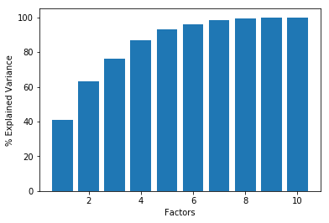
Scree Plot
Scree Plot (Cumulative)
96% of Data
From the scree plot, it is evident that first 6 factors contribute highly to variances.
If the first Six factors together explain most of the variability in the original 10 variables, then those factors are clearly a good, simpler substitute for all 10 variables.
We can drop the rest without losing much of the original variability.
var=pca.components_[0]
##Scree Plot
plt.bar(x=range(1,len(var)+1),height=res)
plt.xlabel('Factors')
plt.ylabel('% Explained Variance')
This implies Feature 1,3,7,8,6,9 are the first 6 Principal components that contribute to 96% of variance in system

Slide 14
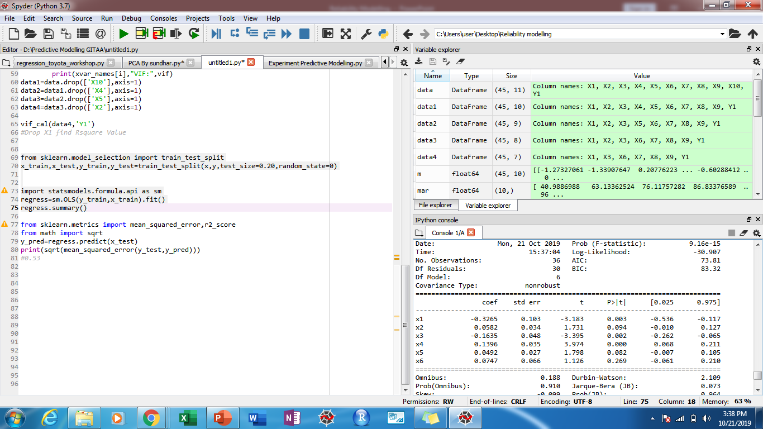
x=data.iloc[:,[0,2,6,7,5,8]].values
y=data.iloc[:,10].values
import statsmodels.formula.api as sm
def vif_cal(input_data,dependent_col):
x_var=input_data.drop([dependent_col],axis=1)
xvar_names=x_var.columns
for i in range(0,len(xvar_names)):
y=x_var[xvar_names[i]]
x=x_var[xvar_names.drop(xvar_names[i])]
rsq=sm.ols("y~x",x_var).fit().rsquared
vif=round(1/(1-rsq),2)
print(xvar_names[i],"VIF:",vif)
data1=data.drop(['X10'],axis=1)
data2=data1.drop(['X4'],axis=1)
data3=data2.drop(['X5'],axis=1)
data4=data3.drop(['X2'],axis=1)
vif_cal(data4,'Y1')
from sklearn.model_selection import train_test_split
x_train,x_test,y_train,y_test=train_test_split(x,y,test_size=0.20,
random_state=0)
import statsmodels.formula.api as sm
regress=sm.OLS(y_train,x_train).fit()
regress.summary()
from sklearn.metrics import mean_squared_error,r2_score
from math import sqrt
y_pred=regress.predict(x_test)
print(sqrt(mean_squared_error(y_test,y_pred)))
#0.53 (Model 1)
X1 VIF: 61.44
X3 VIF: 43.21
X6 VIF: 5.26
X7 VIF: 9.24
X8 VIF: 7.39
X9 VIF: 1.34
R-squared: 0.916
Adj. R-squared: 0.899
Rmse=0.59

Slide 15
OLS Regression Results
==============================================================================
Dep. Variable: y R-squared: 0.916
Model: OLS Adj. R-squared: 0.899
Method: Least Squares F-statistic: 54.20
Date: Mon, 21 Oct 2019 Prob (F-statistic): 9.16e-15
Time: 15:44:01 Log-Likelihood: -30.907
No. Observations: 36 AIC: 73.81
Df Residuals: 30 BIC: 83.32
Df Model: 6
Covariance Type: nonrobust
==============================================================================
coef std err t P>|t| [0.025 0.975]
------------------------------------------------------------------------------
x1 -0.3265 0.103 -3.183 0.003 -0.536 -0.117
x2 0.0582 0.034 1.731 0.094 -0.010 0.127
x3 -0.1635 0.048 -3.395 0.002 -0.262 -0.065
x4 0.1396 0.035 3.974 0.000 0.068 0.211
x5 0.0492 0.027 1.798 0.082 -0.007 0.105
x6 0.0747 0.066 1.126 0.269 -0.061 0.210
==============================================================================
Omnibus: 0.188 Durbin-Watson: 2.109
Prob(Omnibus): 0.910 Jarque-Bera (JB): 0.073
Skew: -0.099 Prob(JB): 0.964
Kurtosis: 2.903 Cond. No. 86.0
==============================================================================

Slide 16


Model I & II Comparison
0.943
0.936
0.916
0.899
X1 VIF: 61.44
X3 VIF: 43.21
X6 VIF: 5.26
X7 VIF: 9.24
X8 VIF: 7.39
X9 VIF: 1.34
X4 VIF: 1.84
X5 VIF: 1.83
X6 VIF: 1.09
X7 VIF: 1.11
Drug Reactivity
Multiple Regression without PCA
Multiple Regression with PCA
Notes:
© Copyright PresentationGO.com – The free PowerPoint and Google Slides template library

Slide 17
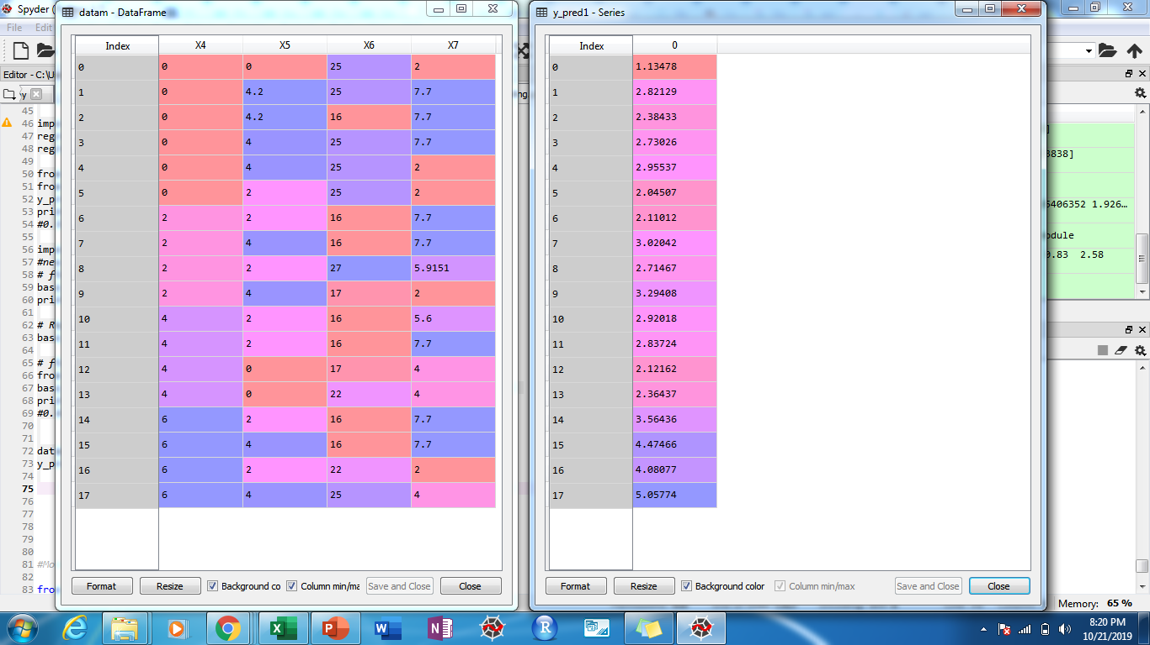
Drug Reactivity Maximization (For given boundary Conditions)
Factors | Drug Composition | Drug Reacted Composition | Process solvent | Delivery Agent | Drug Reactivity
Variables | X4 | X5 | X6 | X7 | Y1
Boundary Values | 0-6 | 0-4 | 16-27 | 0-20 | 0-3.38
Minimum | 0.0 | 0.0 | 16.0 | 0.0 | 0.0
Maximum | 6.0 | 4.4 | 27.0 | 20.0 | 3.4
Average | 2.2 | 0.8 | 18.1 | 6.0 | 1.7

Slide 18




Drug Reactivity
Response
Feature
Drug
Composition
Feature Vector 4
Drug Reacted Composition
Feature Vector 5
Component Analysis
Feature Vector 6
Process Solvent
Feature Vector 7
Delivery Agent

